Slide 1
K Nearest Neighbours Classifier ML ALGORITHM

Slide 2
MACHINE LEARNING METHODS
There is lot of overlapping between statistical modeling and machine learning. The Regression Models are used extensively in ML applications.
Naive Bayes Classifier
Support Vector Machines
K Nearest Neighbours Method (KNN)
Random Forest
Decision Trees
Neural Networks
Linear and Logistic Regression
Regression and Machine Learning Algorithms

Slide 3
Contents
Introduction to K Nearest Neighbours (KNN) Algorithm
KNN for Classification
Measuring Distance
Distance Based on Standardised Variables
Selection of K
Voting Rules in KNN Classification
KNN Classification in PYTHON
KNN for Regression

Slide 4
KNN for Classification
Training dataset has 11 observations
belonging to two categories.
12th observation is introduced,
class of which is not known.
Nearest neighbour algorithm classifies
new observation to the class of the training observation closest to it.
When K=1, nearest one case is considered
As we go on increasing K, classification may vary
?
Three most important components of this method are Distance between cases, Value of K and Voting criteria.
K | Classification
1 | Blue
3 | Blue
5 | Green

Slide 5
Simple Example To Understand KNN Method
Age | Current Debt | Default
25 | 40,000 | N
35 | 60,000 | N
45 | 80,000 | N
20 | 20,000 | N
35 | 120,000 | N
52 | 18,000 | N
23 | 95,000 | Y
40 | 62,000 | Y
60 | 100,000 | Y
48 | 220,000 | Y
33 | 150,000 | Y
48 | 142,000 | ?
New observation will be classified as “N” or “Y” based on KNN method

Slide 6
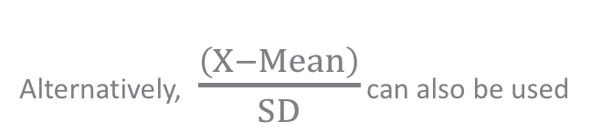
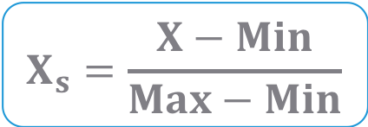
Distance Based on Standardised Variables
$$X_{s}=\frac{X−Min}{Max−Min}$$
Alternatively, $\frac{\left(X−Mean\right)}{SD}$ can also be used
Age | Current Debt | Default
0.125 | 0.11 | N
0.375 | 0.21 | N
0.625 | 0.31 | N
0 | 0.01 | N
0.375 | 0.50 | N
0.8 | 0.00 | N
0.075 | 0.38 | Y
0.5 | 0.22 | Y
1 | 0.41 | Y
0.7 | 1.00 | Y
0.325 | 0.65 | Y
0.7 | 0.61 | ?
Distance
0.7652
0.5200
0.3160
0.9245
0.3428
0.6220
0.6669
0.4437
0.3650
0.3861
0.3771
New observation will be classified as “N” based on nearest neighbor(K=1)

Slide 7
Selection of K
The second component of KNN model is selecting the appropriate value for K
If K = 1, the case is classified using the nearest neighbour
However, K is usually greater than 1. Consider the following when choosing K :
Mostly odd numbered K is preferred to avoid tie.
For a very large K the classifier may result in misclassification, as group of nearest neighbours may include data points which are actually located far away from it.
Thumb Rule :
K = sqrt (n)
n is the number of observations in training data

Slide 8
Voting Criteria
Most common criteria for classification decision is Majority Voting.
Frequency of each class in K instances is measured. Class having the highest frequency is attributed to the new case.
Eg. Suppose for K = 7, 4 cases belong to class A and 3 to class B. New case is given class A
Drawback:
Classification is inappropriate when the class distribution is skewed. That is, examples of a more frequent class tend to dominate the prediction of the new example, because they tend to be common among the k nearest neighbors due to their large number.
?
Is there a way to correct this?
One option to remove this drawback is to create training data with equal class frequency. However, this is possible only if data is very large.

Slide 9
Case Study – Predicting Loan Defaulters
Background
Objective
Available Information
The bank possesses demographic and transactional data of its loan customers. If the bank has a robust model to predict defaulters it can undertake better resource allocation.
To predict whether the customer applying for the loan will be a defaulter
Defaulter (=1 if defaulter, 0 otherwise) is the dependent variable
Age group, Years at current address, Years at current employer, Debt to Income Ratio, Credit Card Debts, Other Debts are the independent variables
Sample size is 389

Slide 10
Data Snapshot
BANK LOAN KNN
Variables
Column | Description | Type | Measurement | Possible Values
SN | Serial Number |  | - | -
AGE | Age Groups | Categorical | 1(<28 years),2(28-40 years),3(>40 years) | 3
EMPLOY | Number of years customer working at current employer | Continuous | - | Positive value
ADDRESS | Number of years customer staying at current address | Continuous | - | Positive value
DEBTINC | Debt to Income Ratio | Continuous | - | Positive value
CREDDEBT | Credit Card Debt | Continuous | - | Positive value
OTHDEBT | Other Debt | Continuous | - | Positive value
DEFAULTER | Whether customer defaulted on loan | Binary | 1(Defaulter), 0(Non-Defaulter) | 2
Observations

Slide 11
KNN Classification in Python
# Importing the Libraries
import pandas as pd import numpy as np import matplotlib.pyplot as plt from sklearn.model_selection import train_test_split from sklearn.preprocessing import StandardScaler from sklearn.neighbors import KNeighborsClassifier from sklearn.metrics import confusion_matrix, f1_score, precision_score, recall_score, accuracy_score, roc_curve, roc_auc_score

Slide 12
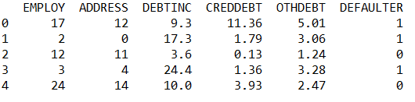
KNN Classification in Python
# Importing the Data
bankloan = pd.read_csv("BANK LOAN KNN.csv")
# Preparing data by removing unwanted variables
bankloan1 = bankloan.drop(['SN','AGE'], axis = 1) bankloan1.head()
drop() is used to remove unwanted variables. AGE is removed because it is a categorical variable.
axis = 1 drops columns.
# Output

Slide 13
KNN Classification in Python
# Creating Train and Test Datasets
X = bankloan1.loc[:,bankloan1.columns != 'DEFAULTER'] y = bankloan1.loc[:, 'DEFAULTER'] X_train, X_test, y_train, y_test = train_test_split(X, y, test_size=0.30, random_state = 999)
train_test_split() from sklearn.model_selection is used to split dataset into random train and test sets.
test_size represents the proportion of dataset to be included in the test set
random_state sets the seed for the random number generator

Slide 14
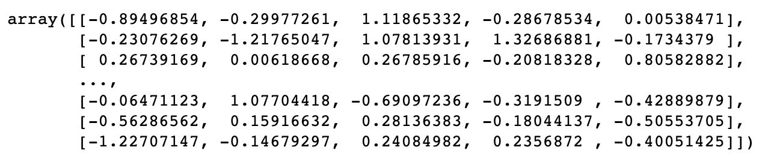
KNN Classification in Python
# Preparing Variables
StandardScaler() from sklearn.preprocessing is a generic function used for centering or scaling columns of a numeric matrix. The default method for scaling is (X-Mean)/SD.
scaler = StandardScaler() scaler.fit(X_train) X_train = scaler.transform(X_train) X_test = scaler.transform(X_test) X_train
# Output
All the continuous predictors are now scaled to mean=0 and sd=1.
Note: Test data is transformed using the train data parameters

Slide 15
KNN Classification in Python
# Building the KNN Classifier (Continuous Predictors)
KNNclassifier = KNeighborsClassifier(n_neighbors = int(np.sqrt(len(X)).round())) # using thumb rule k ~= sqrt(n) KNNclassifier.fit(X_train, y_train)
KNeighborsClassifier() from sklearn.neighbors performs k-nearest neighbour classification
n_neighbors= specifies the value of k.

Slide 16
KNN Classification in Python
# Predictions on Test Data
y_pred = KNNclassifier.predict(X_test)
predict() predicts the class labels of the provided data. The default threshold is 0.5.
# Confusion Matrix
confusion_matrix(y_test, y_pred, labels=[0, 1]) array([[49, 7], [24, 37]])
accuracy_score(y_test, y_pred) 0.7350427350427351
precision_score(y_test, y_pred) 0.8409090909090909
recall_score(y_test, y_pred) 0.6065573770491803
accuracy_score() = number of correct predictions out of total predictions
precision_score() = true positives / (true positives + false positives)
recall_score() also known as ‘Sensitivity’ = true positives / (true positives + false negatives)
*
Note : Output will be slightly different as observations are randomly assigned to train-test data.

Slide 17
KNN for Regression
KNN algorithm can also be extended to regression problems, i.e. when the dependent variable is continuous
Process flow for classification and regression is the same, except for the last step
Average value of the response variable for k neighbours is calculated and assigned to the new case.
Standardise Variables
Calculate Distances
Choose Appropriate k
Average the Response Variable for k Neighbours
KNeighborsRegressor() from sklearn.neighbors can be used to run k-nearest neighbour regression in Python.

Slide 18
Get an Edge!
KNN can be used for categorical variables as well.
Before executing knn on train-test data, categorical variables have to be converted to numeric variables by creating dummy variables.

Slide 19
Quick Recap
In this session, we learnt about KNN Classifier :
KNN for Classification
Three most important components of this method are Distance between cases, Value of K and Voting criteria.
KNN for Classification in Python
KNeighborsClassifier() from sklearn.neighbors.
KNN for Regression
KNN algorithm can also be extended to regression problems when the dependent variable is continuous.
KNN for Regression in Python
KNeighborsRegressor() from sklearn.neighbors.

Slide 20
THANK YOU!!

